Slide 1
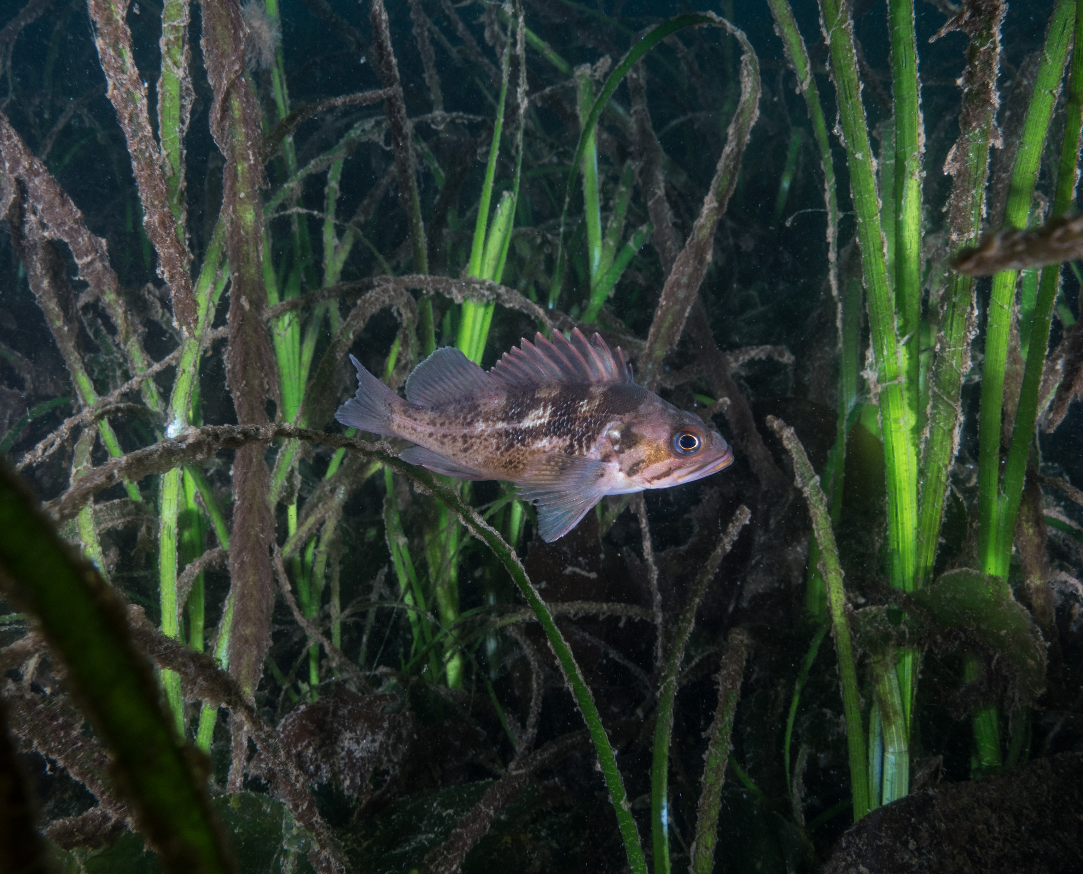




Young-of-year Rockfish Program
How to Survey for YOY Rockfish

Slide 2
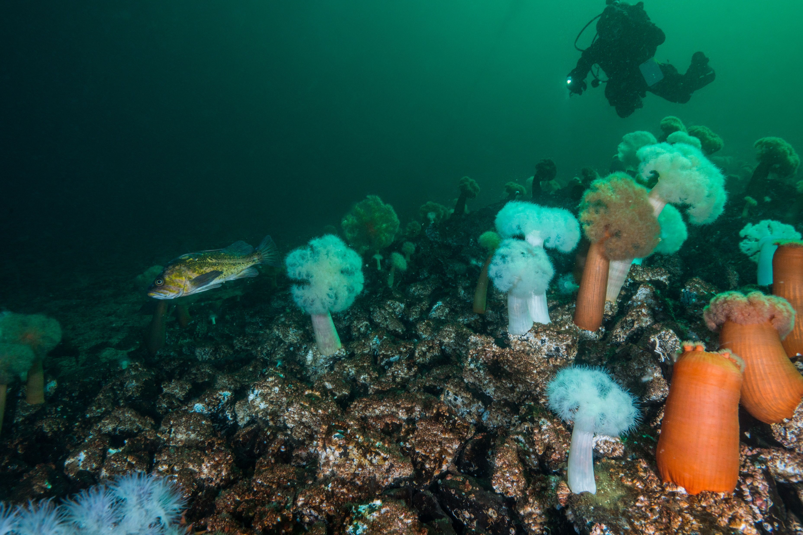
So you want to survey for rockfish
Smart Move!
Fill data gaps on listed species
Take part in restoring Puget Sound
Learn about scientific data collection
Impress friends with your fish knowledge
Explore new dive sites
Improve search ability (i.e. you will look at sites in a new way)

Slide 3
How do I start?
Connect with survey leader (e.g. Harbor WildWatch, Emerald Dive Club)
Review survey information found on NOAA webpage (https://www.fisheries.noaa.gov/species/yelloweye-rockfish#science)

Slide 4
How does the survey work?
Divers conduct a timed “roving” survey through discrete habitat and depth zones
Please slow down, I don’t understand all those terms!
Roving survey means swimming around and counting all the young-of-year rockfish you see
Discrete habitat and depth zones mean each survey is conducted in a specific habitat type (e.g. kelp, rocky or artificial reef, eelgrass) and depth bin (< 21 feet, 21-60 feet and > 60 feet)
Note the time you start and finish searching in a new habitat type and depth bin. You can do it on your dive computer!
By timing surveys and breaking them into habitat and depth bins, we can learn a lot about rockfish abundance and habitat associations!!!

Slide 5
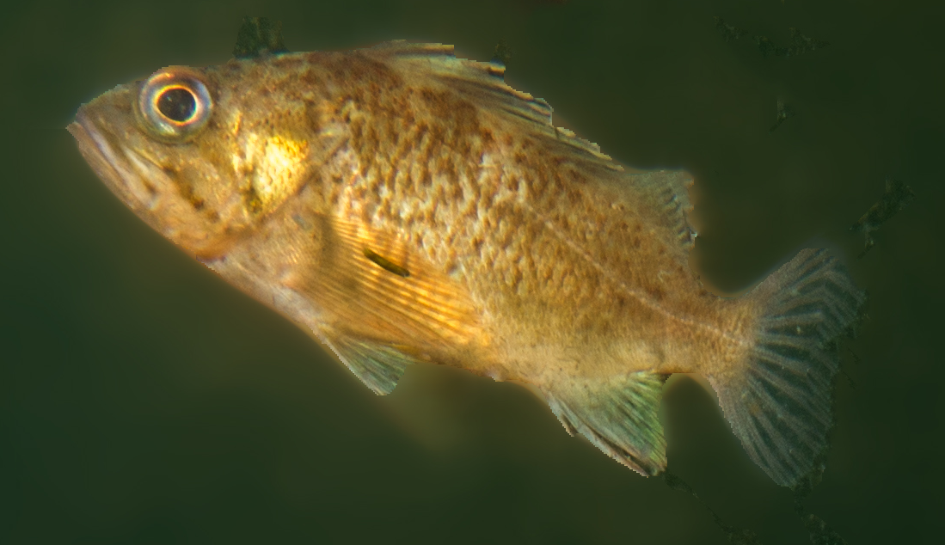
What is a Young-of-Year Rockfish?
Young of year rockfish are those that have recruited to the site in the last year.
Because we can’t age fish perfectly by sight, we count anything less than 10 cm as a YOY
For reference, 10 cm is a little less than the size of a soda can or a smart phone

Slide 6
Aren’t little rockfish hard to ID?
Yep!
But fortunately you don’t need to identify to species level for this work!
Step 1 – Is it a rockfish?
It may be helpful to learn some other species that are not rockfish that may be easily confused (e.g. shiner surfperch, sculpin)
Step 2 – Does it have an elongate or deep body?
Step 3 – Does it have a black spot on dorsal fin?
Presence/Absence of Dorsal Spot
Body Type

Slide 7
Can I learn more?
Sure – check out the survey guide on the NOAA page!

Slide 8
Do you also want information on habitat?
Yes! But don’t panic, it’s super basic
There are a few questions on whatever habitat type for you to provide qualitative responses

Slide 9
More Questions
Where do I submit data?
You can email NOAA project leads directly (RockfishID@noaa.gov,
Adam@pauamarineresearch.com or James.Selleck@noaa.gov) or
your survey leader can provide you with datasheets to fill out that they can submit or
we can provide you with link to Google Sheet to input data directly
Should I submit data if I don’t find any YOY rockfish?
Yes!!! Zeroes are just as important as any other count
Do I have to survey at specific sites?
Not at all, you can do a survey anywhere. If you want to go to a popular dive site, great. If you want to try a new site, also great!

Slide 10
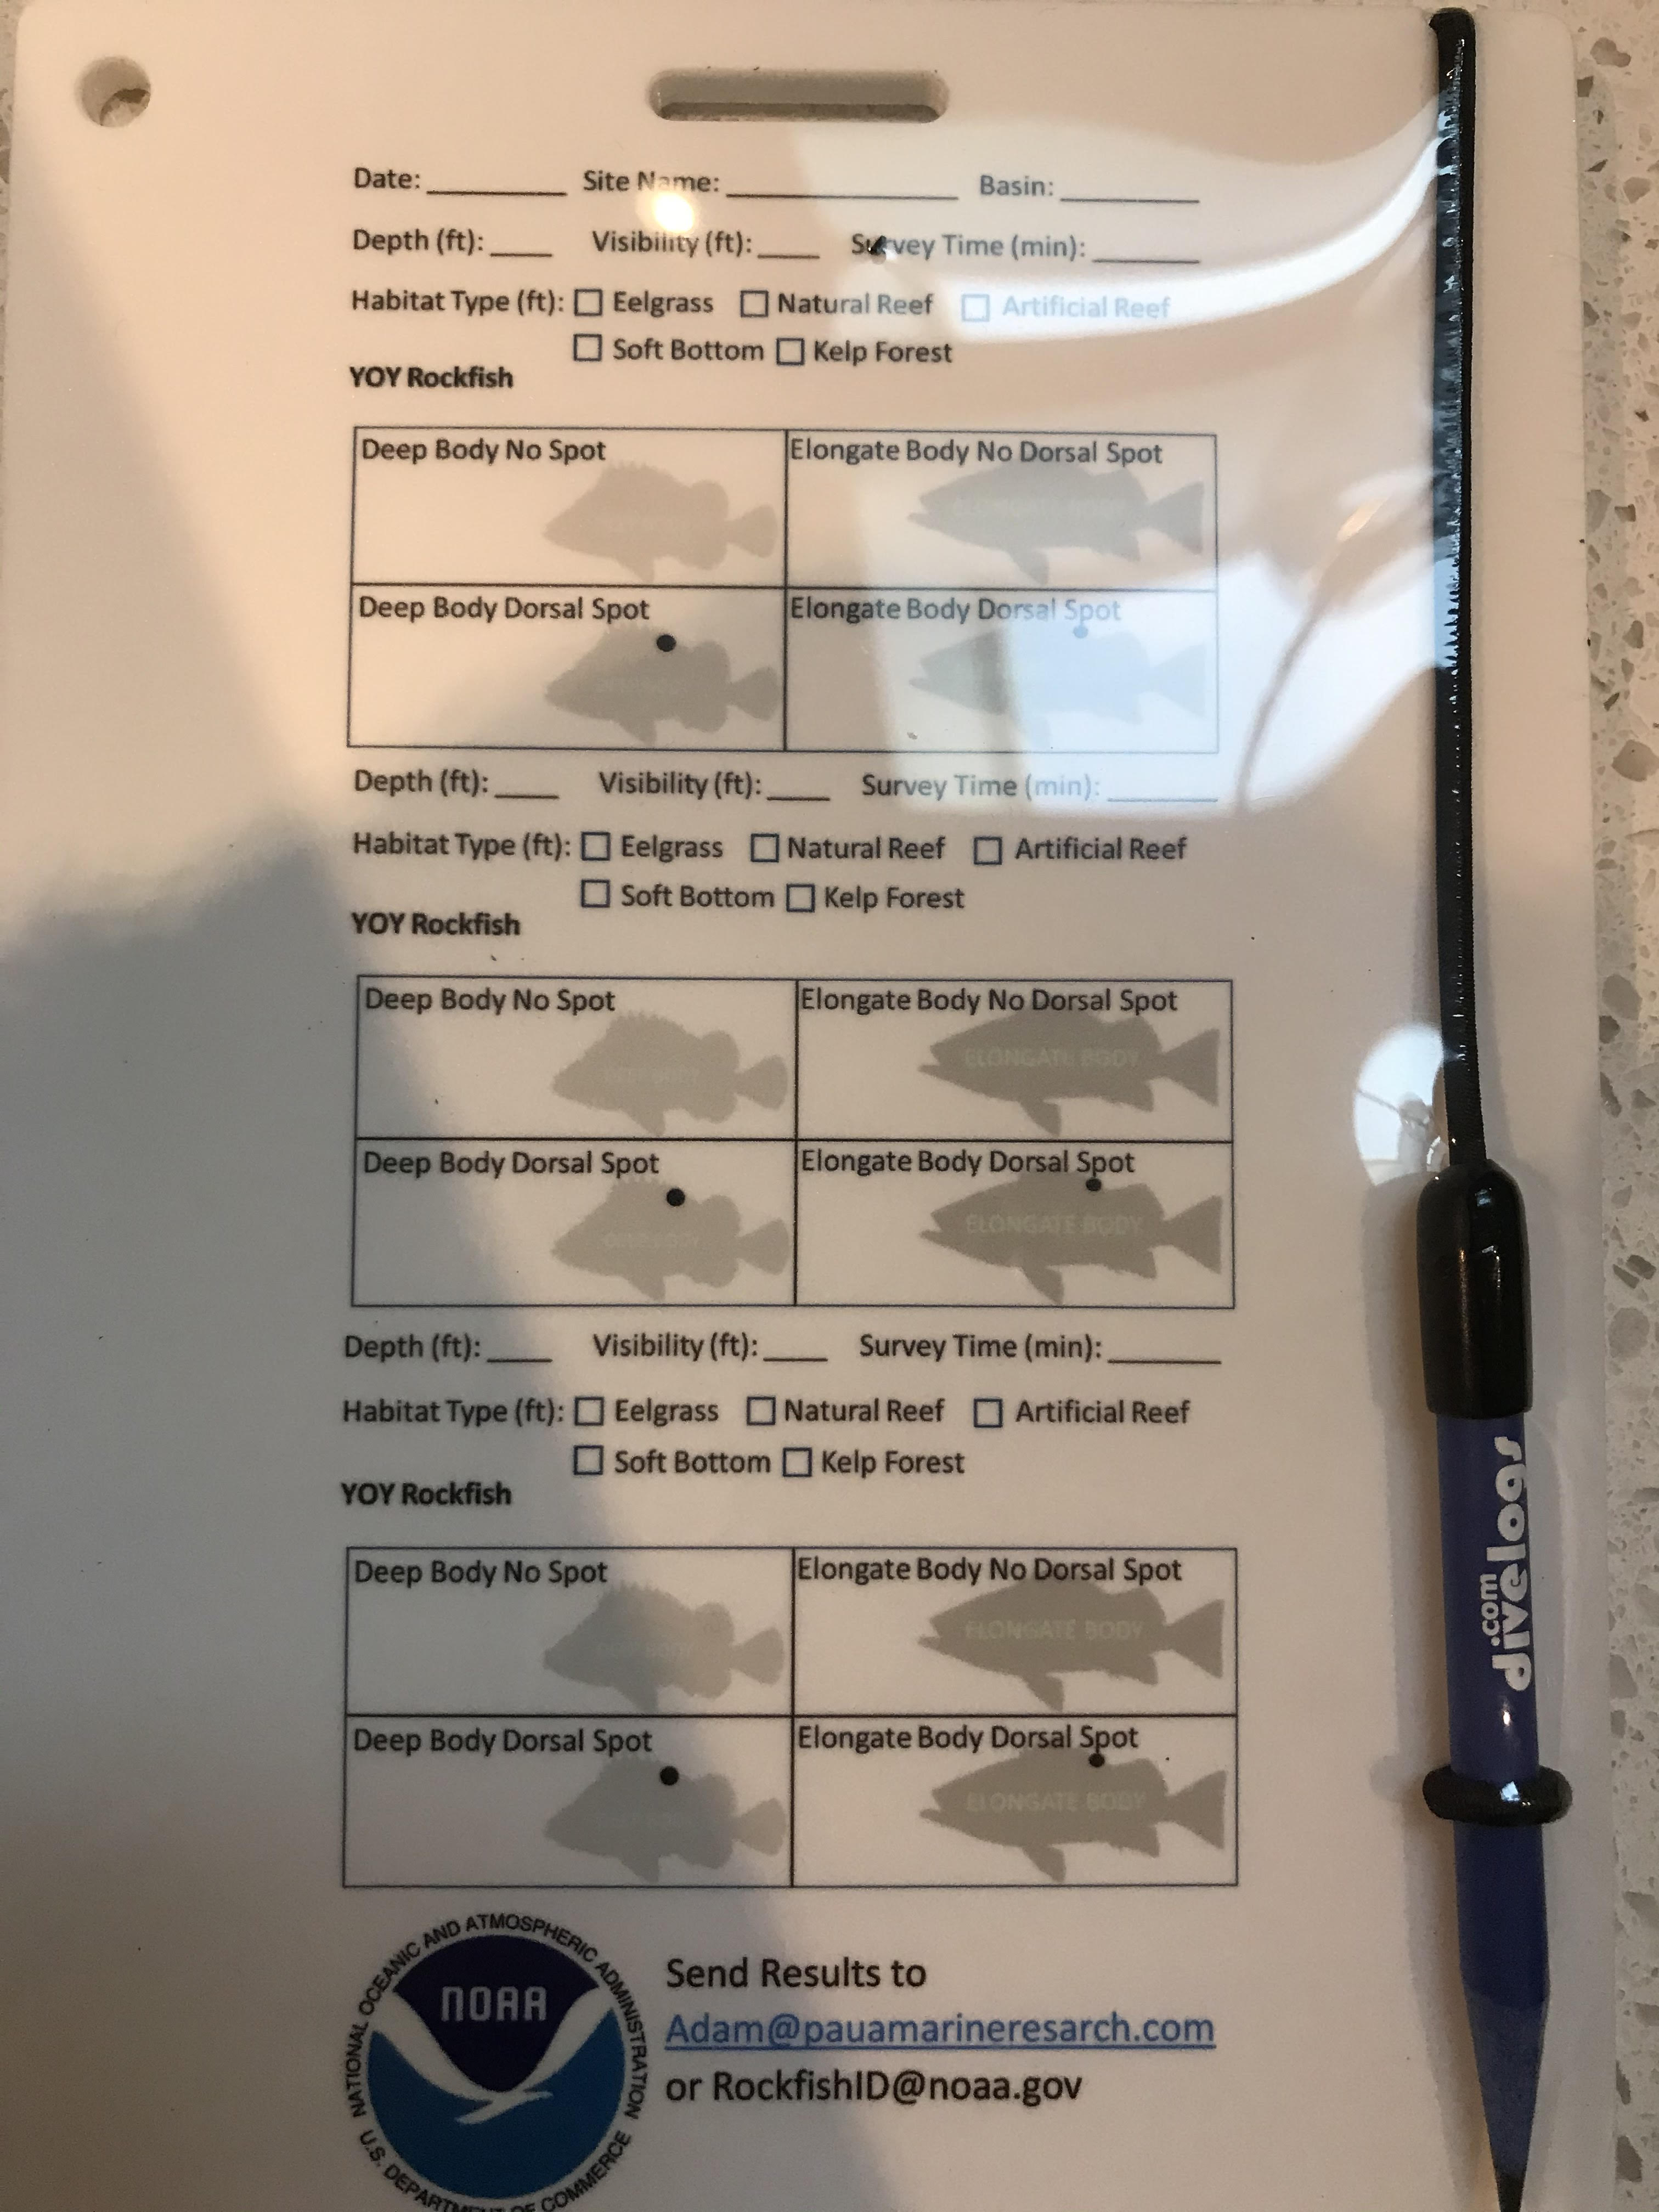
Slate Setup
Site/Survey Information
Habitat Information
YOY Tallies
Survey 2
Survey 3

Slide 11
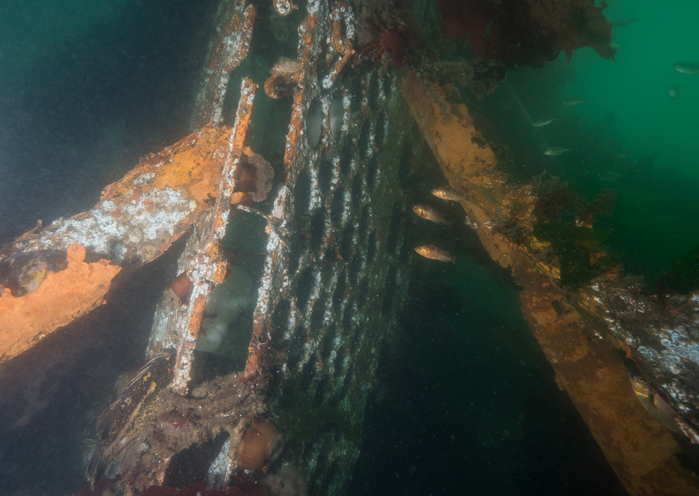
Search Images

Slide 12
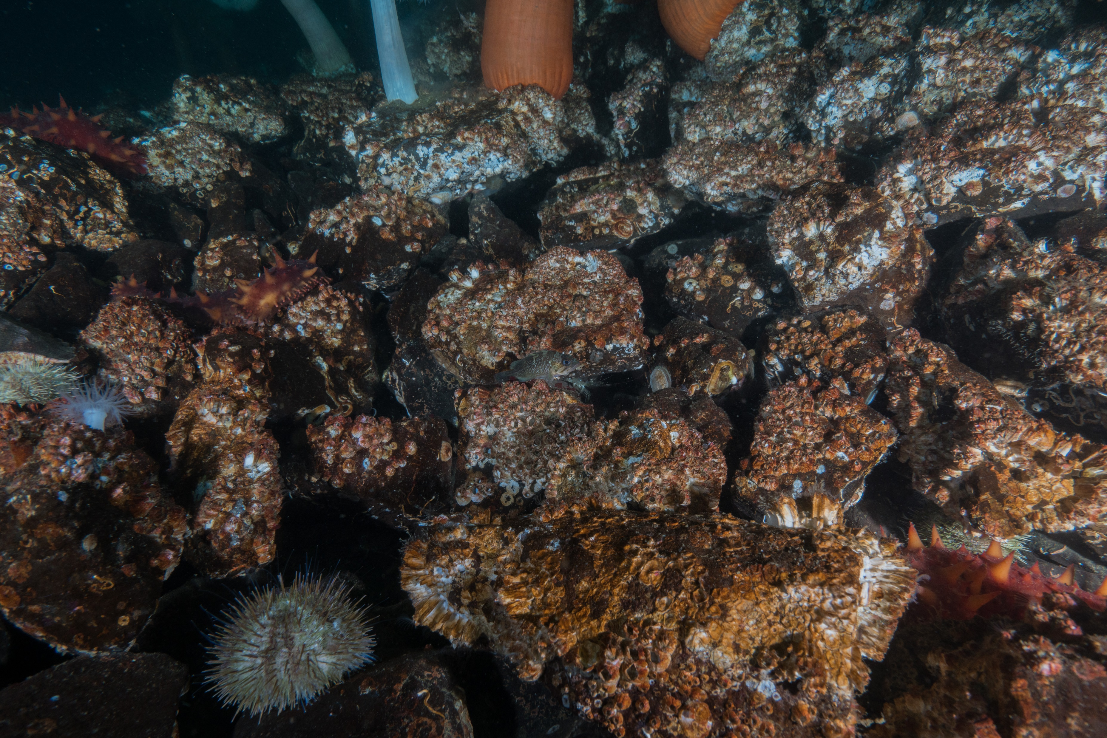

Search Images

Slide 13
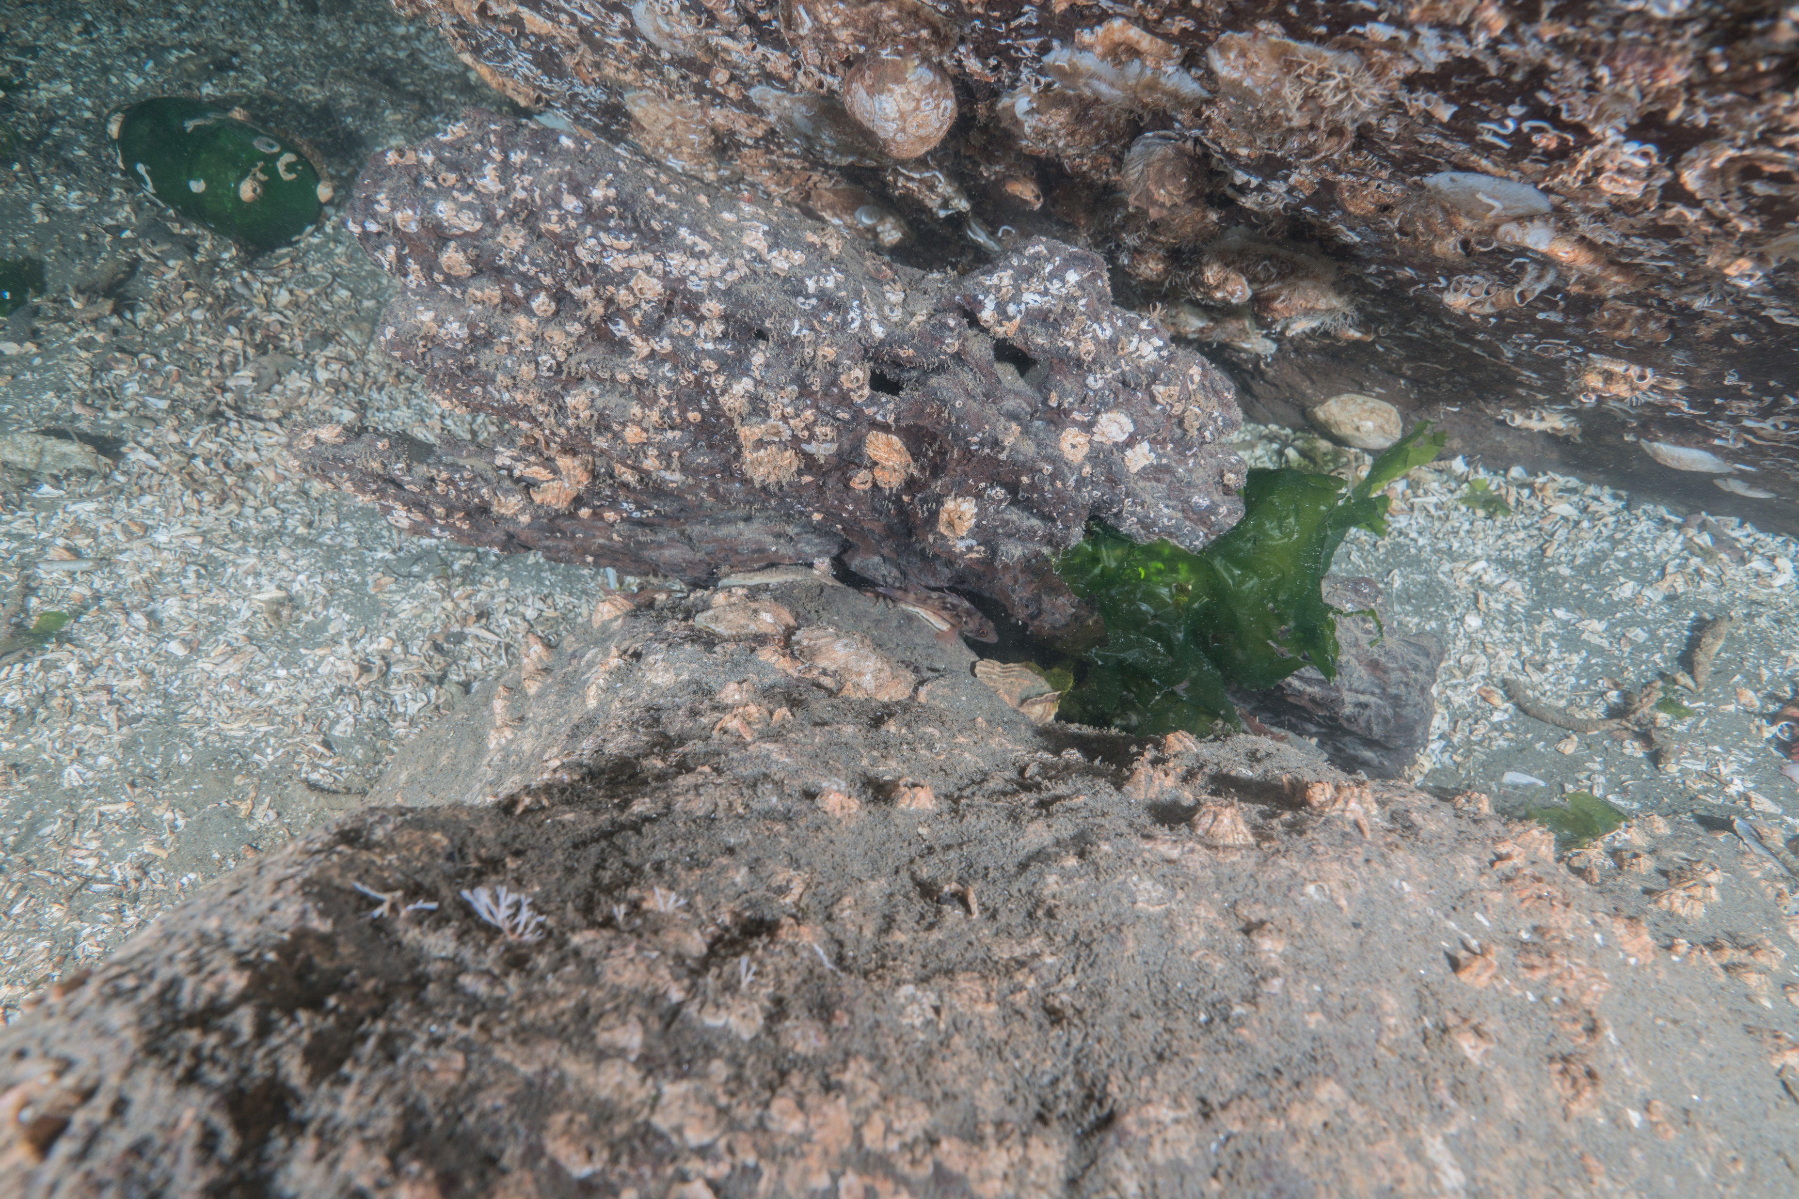
Search Images

Slide 14
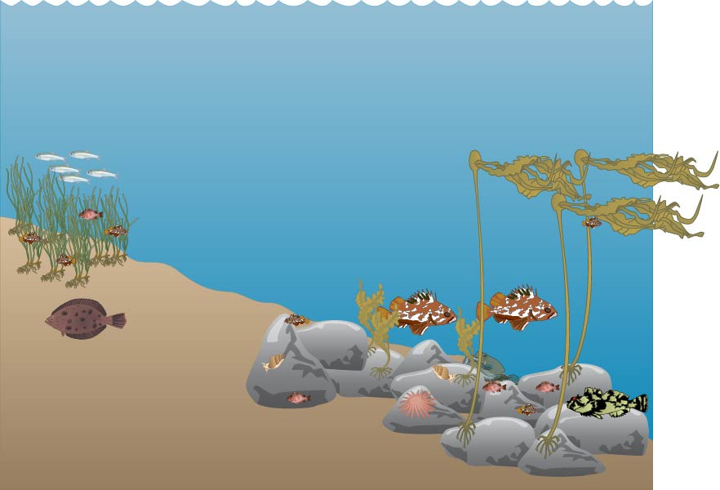
Practice Survey

Slide 15
Practice Survey
A
B
C
D

Slide 16
Practice Survey
A
B
C
D

Slide 17
Practice Survey
Data to report for A
Number of minutes to complete survey
4 Deep body no dorsal spot YOY
Habitat Type (eelgrass) with basic characteristics
  Density
  Blade height
Depth bin (likely shallow)
A

Slide 18


Practice Survey
Data to report for B
Number of minutes to complete survey
0 YOY
Habitat Type (soft bottom) with basic characteristics
  Sediment type
  Macroalgae abundance
Depth bin
B

Slide 19
Practice Survey
Data to report for C
Number of minutes to complete survey
2 Deep body no dorsal spot YOY
Habitat Type (natural reef) with basic characteristics
  Relief
  Abundance of macroalgae
Depth bin
C

Slide 20
Practice Survey
D
Data to report for D
Number of minutes to complete survey
Four Deep body no dorsal spot YOY
Habitat Type (kelp forest) with basic characteristics
  Kelp density
  Canopy height
Depth bin

Slide 21
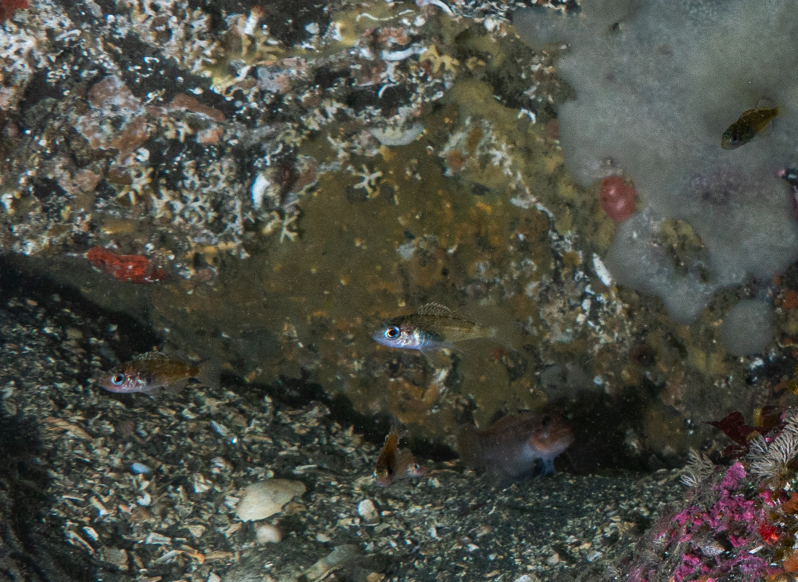
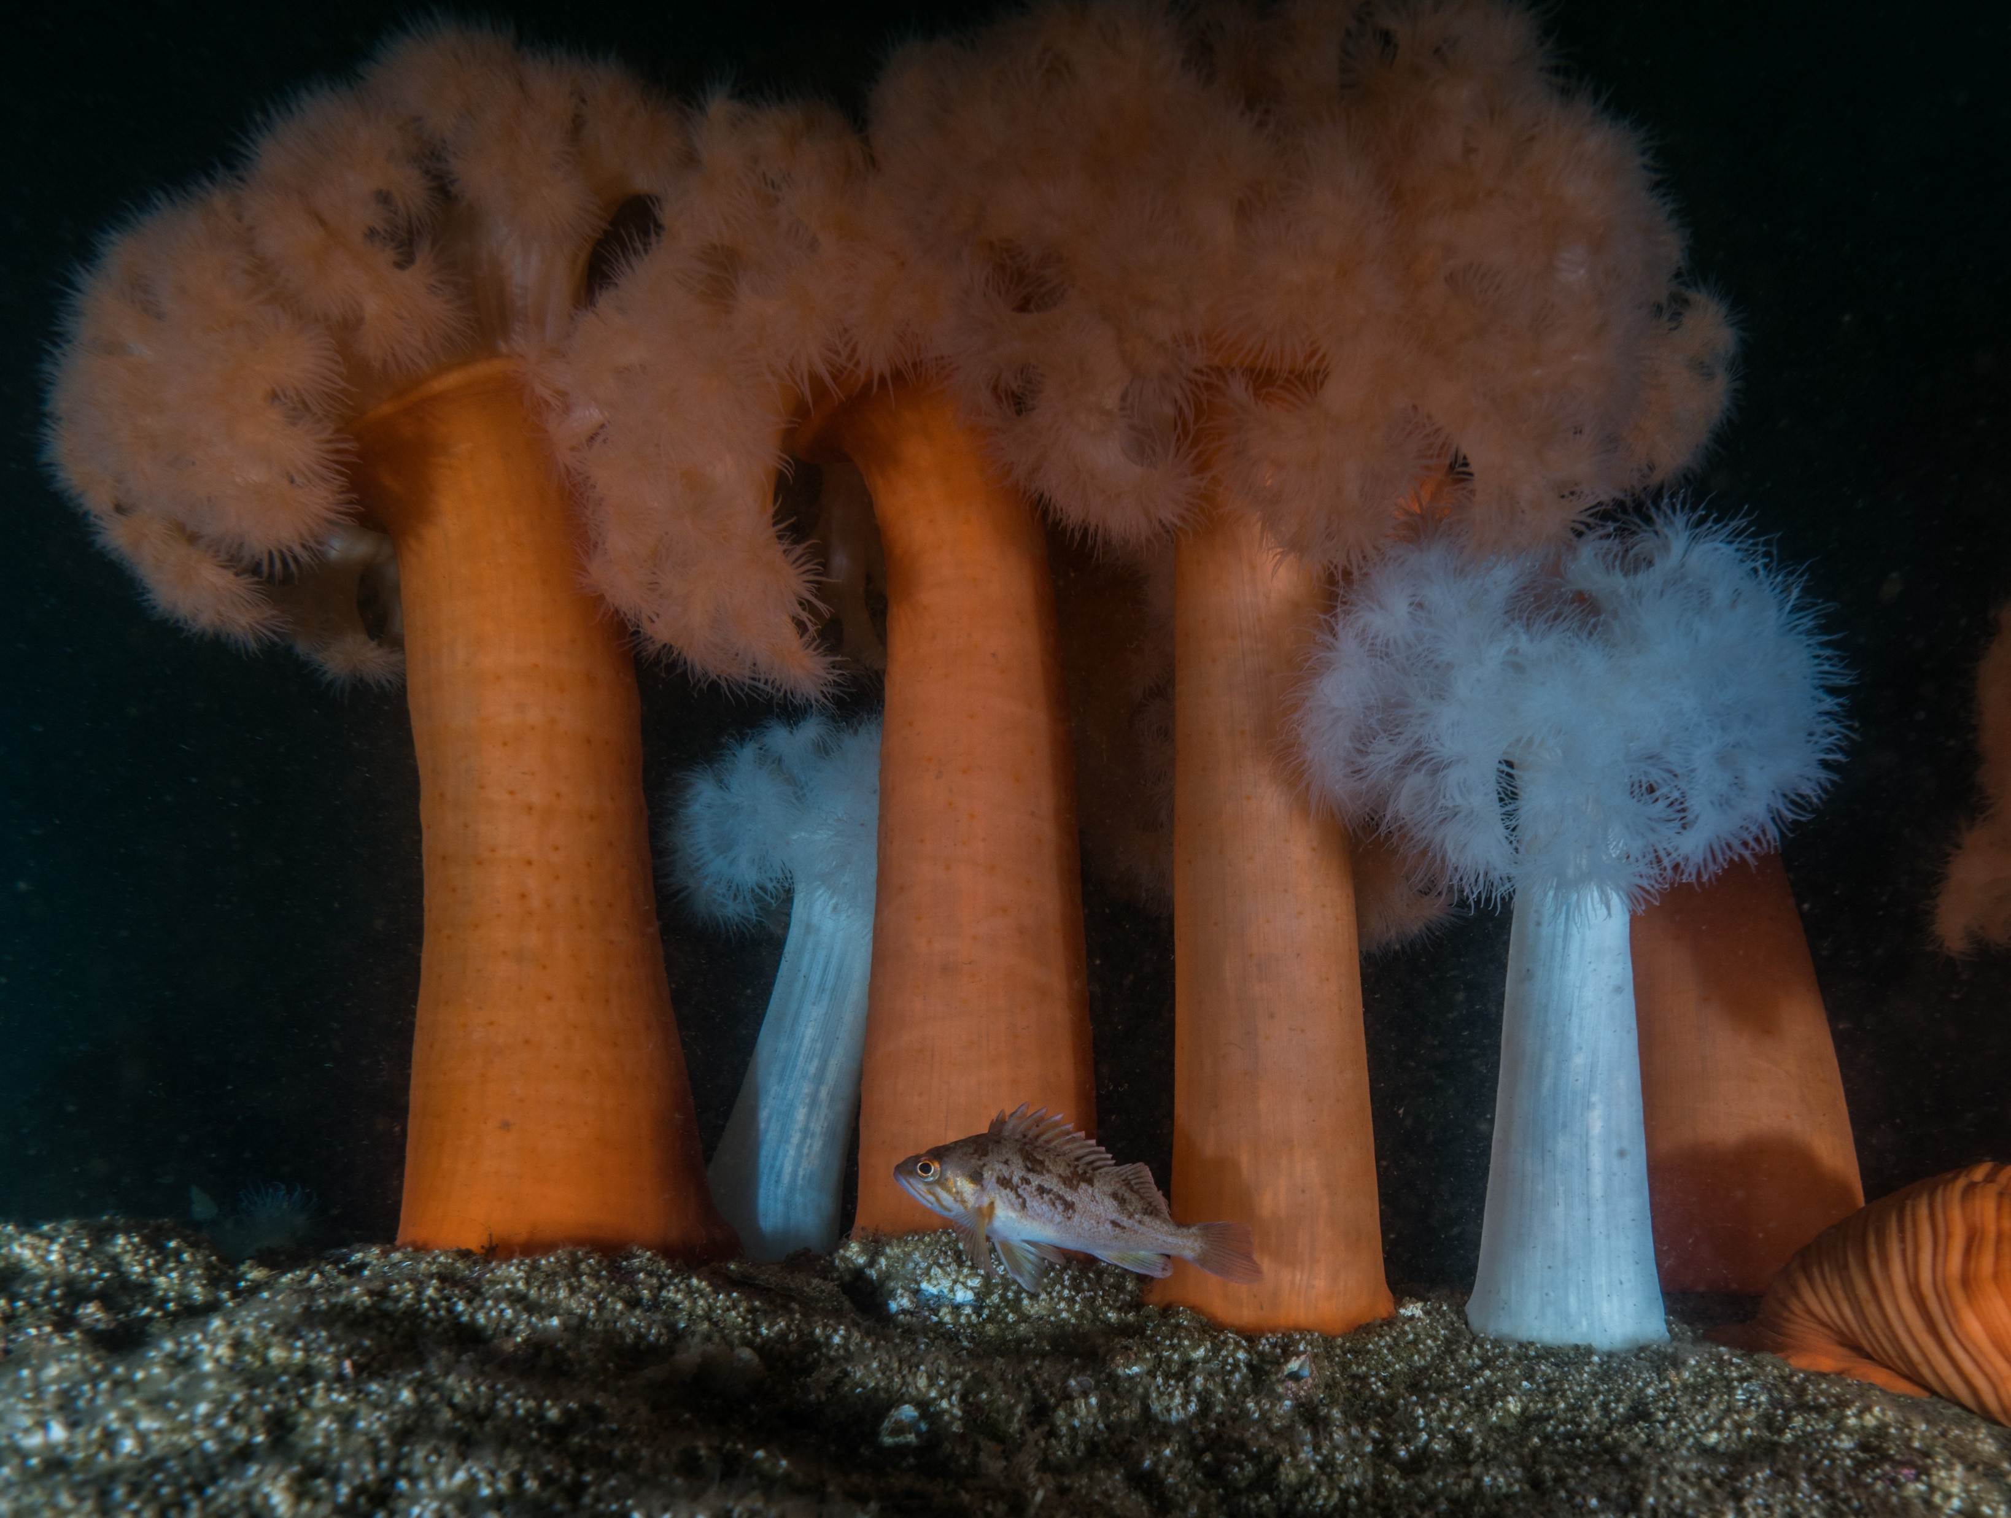
Practice Survey
Send in results to project lead, or:
Adam@pauamarineresearch.com
James.Selleck@noaa.gov
RockfishID@noaa.gov
We also love pictures!!!

Slide 22
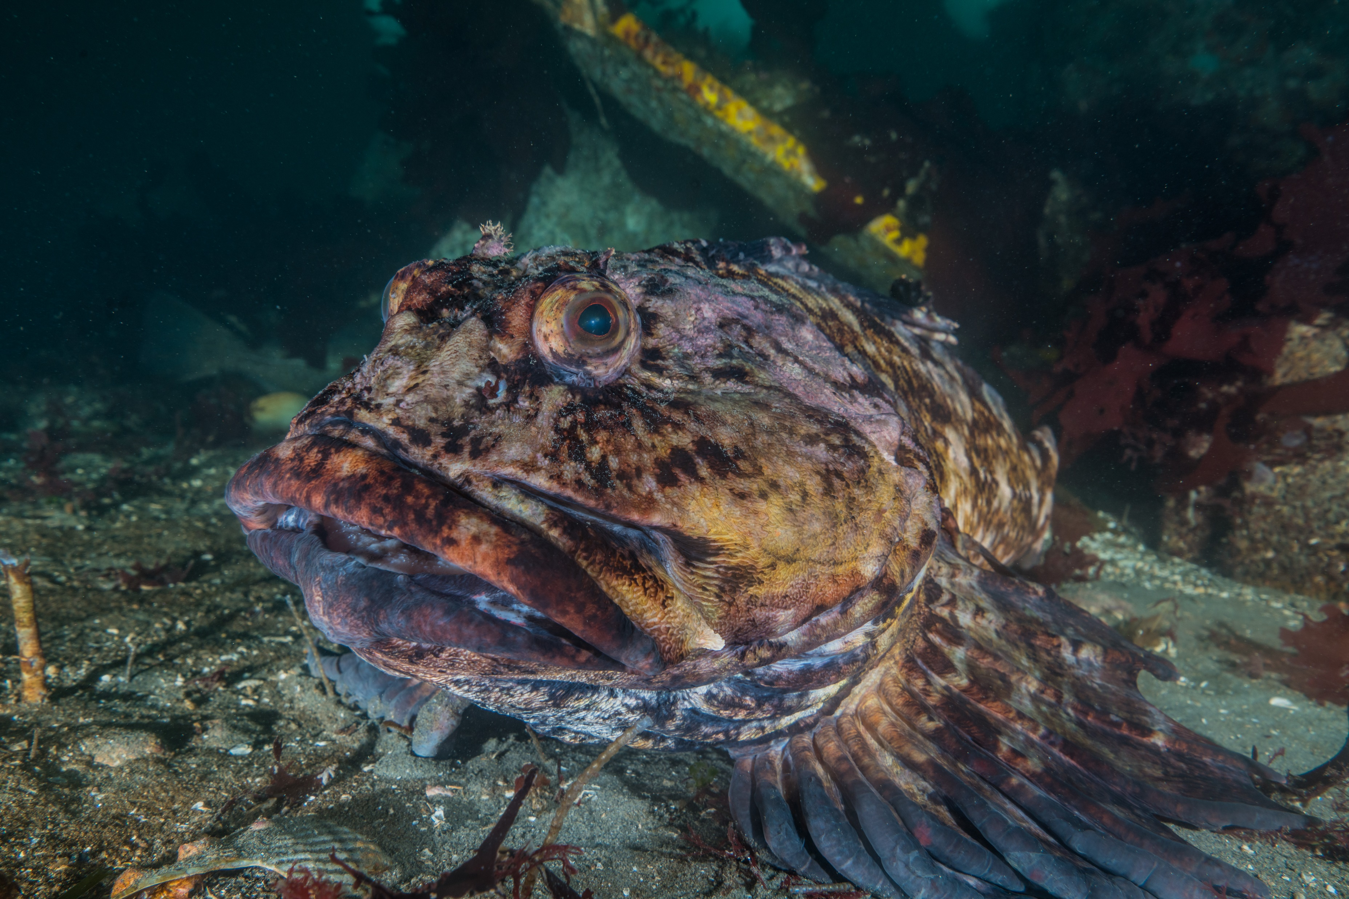
Questions?
Email:
Adam@pauamarineresearch.com
James.Selleck@noaa.gov
RockfishID@noaa.gov

